Slide 1
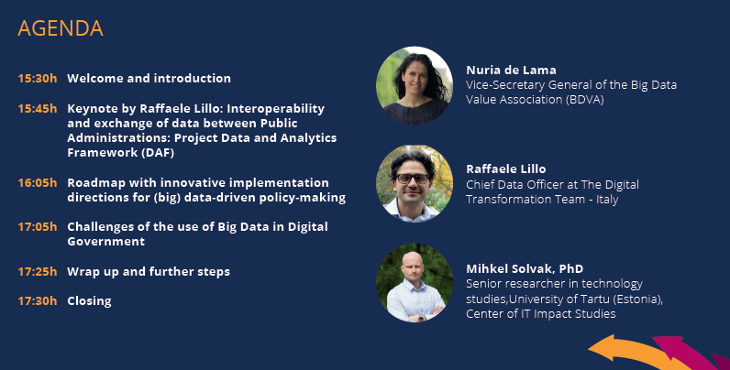

Slide 2
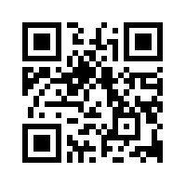
Defining the Future of Decision and Policy Making through Big Data
Introduction
Nuria Rodríguez (ATOS)
2nd Big Policy Canvas Workshop
(Vienna, 14/11/2018)
www.BigPolicyCanvas.eu
This project has received funding from the European Union’s Horizon 2020 research and innovation programme under grant agreement No 769623

Slide 3
Introduction to the project
Who we are
Our Vision & Mission
Big Policy Canvas Offering
Big Policy Canvas & BDVA
Workshop focus

Slide 4
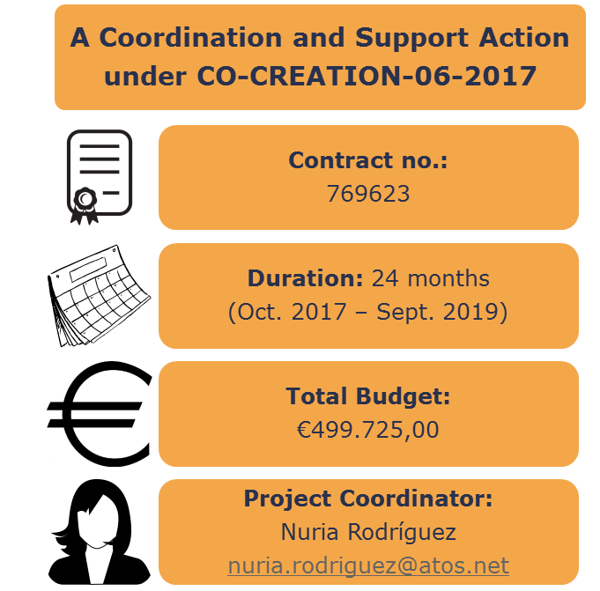
Who we are

Slide 5
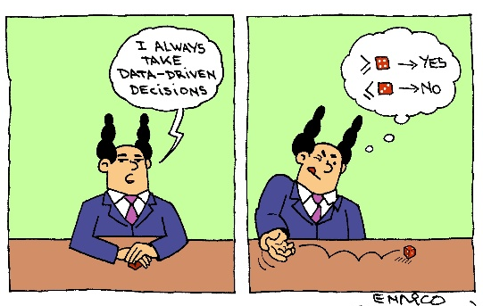
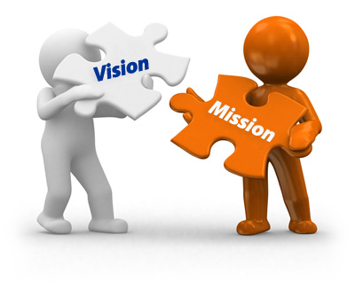
Our Vision & Mission
Transform the public sector to an effective, efficient, precise, consistent and evidence-based policy making structure
Foster collaboration amongst relevant stakeholders & offer the knowledge base, research directions and recommendations towards materialising this vision

Slide 6
Big Policy Canvas Offering
Needs & trends Identification
Analysis of methods & tools
Methodological framework
Stakeholders community
Knowledge base
Collaborative platform
Roadmap & research directions
Notes:
Solid network of experts that will feed up, use and sustain the BPC results
List of Public Administrations’ needs, trends and barriers
Analysis of methods and tools for the effective exploitation of relevant data in order to move to a big data-based policy model.
BPC support collaboration platform & knowledge repository
BPC methodological framework
BPC roadmap and research directions & recommendations

Slide 7
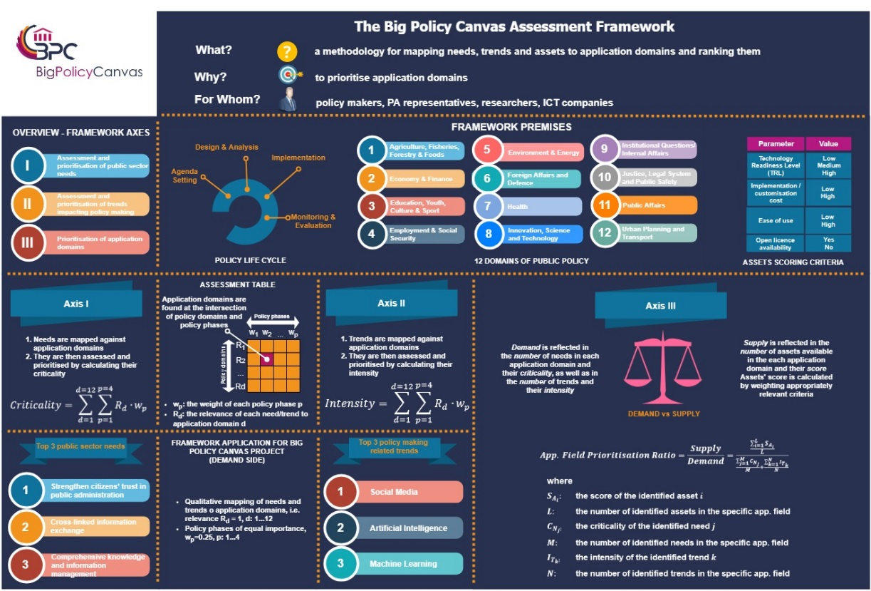
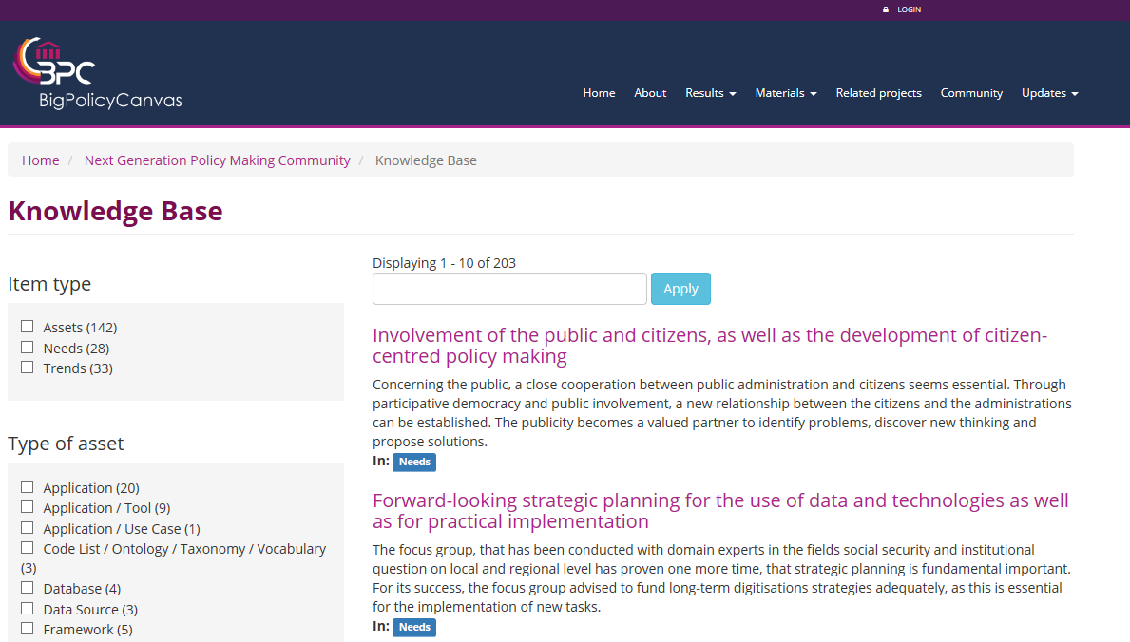
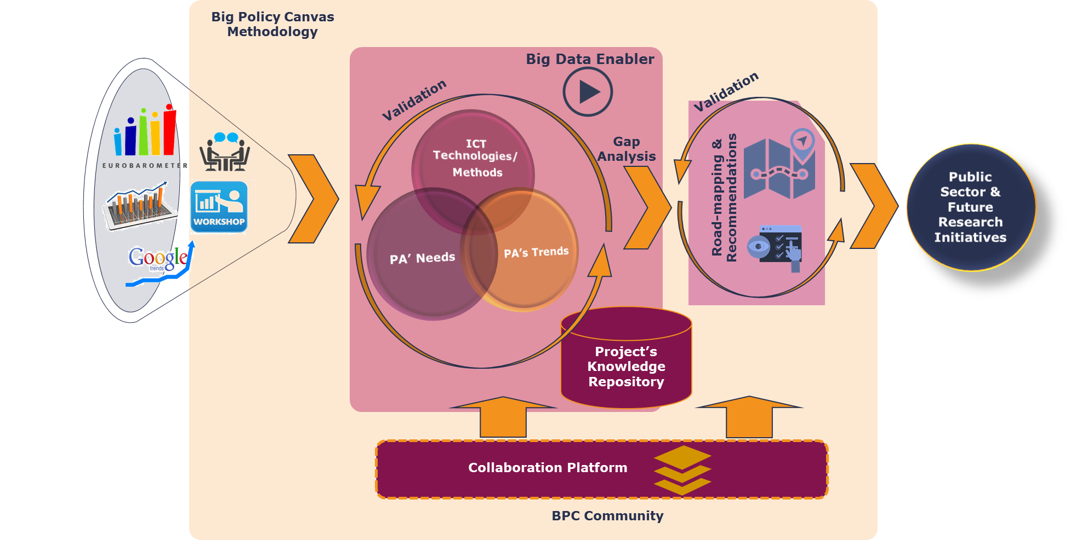
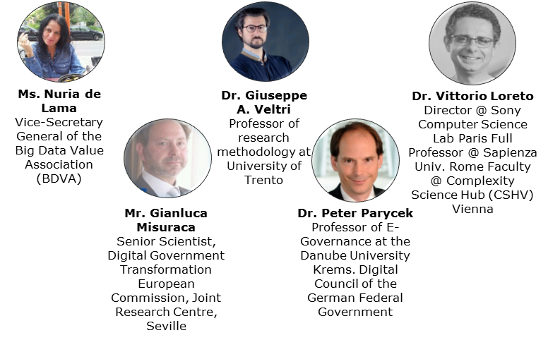
Big Policy Canvas Offering
A complete methodological framework for improving public sector readiness with regard to the integration of Big Data for the achievement of informed, evidence-based policy development in highly important application fields
Assets
Needs
Trends

Slide 8
Big Policy Canvas & BDVA
Public Sector
Notes:
Fill the gap existing in terms of Public Sector and help generate an innovation ecosystem that includes industry, academia and Public Sector representatives.

Slide 9
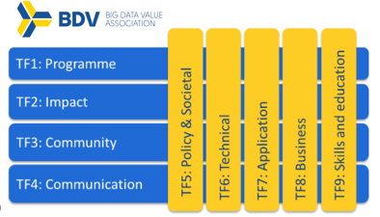
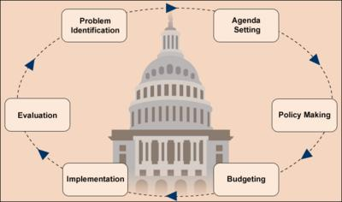
Big Policy Canvas & BDVA
TF7: Identify applications in which big data technologies can create the biggest impact in Europe
Sub-groups: Smart Cities.
Notes:
broaden the scope of the subgroup mandate and include the application of Big Data in decision and policy making processes.

Slide 10
Big Policy Canvas & BDVA
Notes:
we get access to the Big Data community (and strategical partnerships) and all BDVA marketing tools.

Slide 11
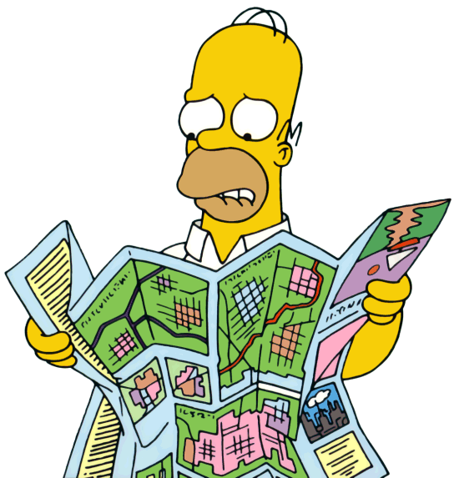
Workshop focus
Roadmap for Future Research Directions in Data-Driven Policy Making
Notes:
Put forward the different research and innovation directions that should be followed in order to reach the anticipated vision for making the public sector a key player in tackling societal challenges through new data-driven policy-making approaches.
On the other hand, and to materialize this collaboration, we will present future research challenges and application scenarios related to the use of big data in policy making that have been proposed by the project’s Experts Committee and will ask the participants to help us in the production of the Roadmap for Future Research Directions in Data-Driven Policy Making, one of the main outputs of the project.

Slide 12
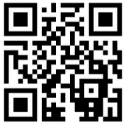
Thank you for your attention!
Nuria Rodríguez Domínguez
(nuria.rodriguez@atos.net)
This project has received funding from the European Union’s Horizon 2020 research and innovation programme under grant agreement No 769623
www.BigPolicyCanvas.eu

