Slide 1
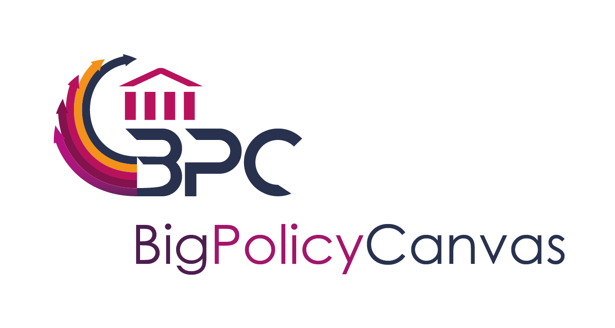
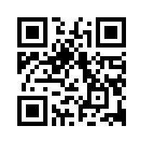
Big policy Canvas Roadmap
Defining the Future of Decision and Policy Making through Big Data
Dr Francesco Mureddu - Lisbon Council
Vienna – 14 November 2018
www.BigPolicyCanvas.eu
This project has received funding from the European Union’s Horizon 2020 research and innovation programme under grant agreement No 769623

Slide 2
Methodology For the Interactive Part
Interactive session in the BDVF Workshop
Presentation of the Research challenges
Participants will cluster according to their interest in Transparency, Data Ownership, Privacy and Security, Data Collection and Linking, Simulations and Decision Support Tools and will answer the questions in the sheet of paper provided
The questions in the paper are:
Please add a research challenge related to your cluster
Why is this challenge important in the policy making process? Which is the need that is addressed in the policy making process?
Which technologies should be developed to cope with these challenge?
The organizers will shortlist the most interesting challenges provided during the presentation by Mikel Solvak
The attendants will vote the best challenge and the winner will receive our gorgeous prize

Slide 3
The Big Policy Canvas Roadmap Overview
What?
Roadmap for Future Research Directions in Data-Driven Policy Making, building on Crossroad and Crossover Roadmaps
Put forward the different research and innovation directions that should be followed in order to reach the anticipated vision for making the public sector a key player in tackling societal challenges through new data-driven policy-making approaches
First version March 2019 (M18), final version September 2019 (M24)
https://www.bigpolicycanvas.eu/results/roadmap
Policy makers, PA representatives, researchers
Why?
When?
Where?
For Whom?

Slide 4
Methodology to Develop the Roadmap (1)
Input from experts
Literature review
WP3: PA Needs, Trends & Barriers Landscape
Literature review
Vienna workshop
Input from experts: brainstorming day
Preparatory and introductory part to the roadmap
Map of methods, technologies and tools to the public sector needs, trends, barriers
Evidence-based gap analysis in the public administration sector
First definition of research challenges
Refinement of research challenges and transformation into recommendations
WP4: PA oriented Methods, Tools & Technologies Landscape
Comments in the published version
Comments in the published roadmap and call for input

Slide 5
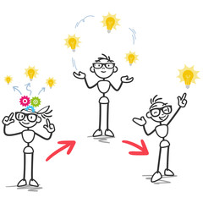
Methodology to Develop the Roadmap (2)
Major points addressed by the roadmap
Which major research challenges should be considered and addressed for evidence-based policy-making and policy-monitoring in order to tackle wider societal challenges
What kind of instruments are necessary to tackle this challenges?
What is the anticipated impact of these challenges to each policy domain and to the society?
Which are the broad recommendation for policy makers, researchers and industry that are meaningful to accelerate the roadmap’s take-up?
www.BigPolicyCanvas.eu

Slide 6
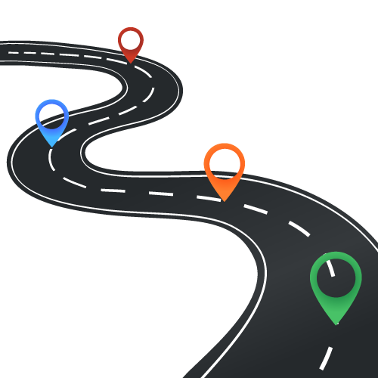
First Results – General Structure
Introduction to the roadmap
Rationale and scope
Methodology
Current status and what is new
Tasks of the policy makers
Key challenges of evidence-based policy making
Data Driven Government
Example of disruptive digital trends based on data
Gaps and research needs
External Framework Analysis
Triangulation of Needs, Trends and Assets
Research Gaps to be filled
Short and long-term research challenges
Structure in following slide
Future Application scenarios
Application Cases
Recommendation for implementation
Research directions and recommendations
Future research directions
Recommendation for research at EU level

Slide 7
First Results – Research Challenges Chapter
Research challenges will be grouped in clusters
For each cluster, we will present:
Description, vision, map against relevant gaps
For each research challenge, we will present:
Description and link with the state of the art
Current status
Research topics
Importance in the policy making process
Timeline (short and long term)
Research tools
Example of research clusters: interoperability, collaborative governance

Slide 8
First Results - Disruptive Digital Trends (1)
Example of disruptive digital trends based on data
Artificial Intelligence: computing technologies inspired by the way people use their brain and nervous system to make decisions. It is expected that the AI would facilitate the access to public sector information as well as to increase the resource productivity of the public organizations
Augmented and Virtual Reality: techniques overlaying virtual objects in the real-world environment, or immersing users in an artificial digital environment. It would improve the way in which citizens could access the public services as well as the increase of civil servants' productivity and enhancing the recruitments and training

Slide 9
First Results - Disruptive Digital Trends (2)
Example of disruptive digital trends based on data
Cloud computing refers to a variety of Internet-based computing services which allow to store data outside one’s organisation. It allows businesses to save costs to run and maintain servers and enhance collaboration. It is expected that cloud computing would make faster and transparent the access to public sector services
Digital platforms provide a bridge between technology and service applications, integrating technologies into applications, products and services. One example is smart factories, where a platform can be used to collect data from machines, allow third parties to develop applications and connect users and developers
Distributed Ledger Technology: allows new ways of creating, handling and sharing access to databases, ensuring a high level of security, efficiency, speed and transparency, being a way of recording lists of transactions. It is expected the possibility of having a faster and more transparent access to public sector services

Slide 10
Clusters and Research Challenges
C1 - Transparency in the Policy Making Action
RC: legitimacy of hypernudging in government, i.e. combination of predictive analytics with behavioral nudge applications (Misuraca and Parycek)
C2 - Data Ownership, Privacy and Security
RC: massive interconnection, i.e. massive number of objects/things/sensors/devices connected through the information and communications infrastructure to provide value-added services
C3 - Methodology for Data Collection and Combination
RC: extraction of mean and data quality: most big data will be a combination of existing and different data sources to be repurposed for another goal
C4 - Simulations and Decision Support Tools
RC: developing effective infrastructures merging the science of data with the development of highly predictive models, to come up with engaging and meaningful visualizations and friendly scenario simulation engines

Slide 11
CLUSTER: Transparency in the Policy Making Action
RC: legitimacy of hypernudging in government, i.e. combination of predictive analytics with behavioral nudge applications (Misuraca and Parycek)
Big Data analytic nudges are extremely powerful due to their continuously updated, dynamic and pervasive nature, working through algorithmic analysis of data streams from multiple sources offering predictive insights concerning habits, preferences and interests of targeted individuals
Importance in policy making: such techniques can be used for anonymous monitoring activities, early warning system for societal phenomenon or agent based simulations, but also profiling and nudging purposes through combining personal small personal data with big data sources
Target Trump campaign who is more likely to vote for him (e.g. people buying American cars)
Better design and target road safety initiatives — to provide the right behavioral interventions for the right people: case of Essex county in UK where most deadly accidents where caused by 40-50 YO
Technologies and tools: machine learning algorithms, behavioural science. Machine learning: modelling an algorithm to find patterns in very large datasets. These algorithms consolidate information and adapt to become increasingly sophisticated and accurate, allowing them to learn automatically without being explicitly programmed

Slide 12
CLUSTER: Data Ownership, Privacy and Security
RC: massive interconnection, i.e. massive number of objects/things/sensors/devices connected through the information and communications infrastructure to provide value-added services (JRC)
Importance in policy making: big data offer the potential for cities to obtain valuable insights from a large amount of data collected through various sources, and the IoT allows the integration of sensors, radio frequency identification, and Bluetooth in the real-world environment using highly networked services. This is extremely important for instance in transport
But there are clear problems related to privacy: from the location of a physical phone to a human with implants
And there are also clear issues related to cyber security and compliance with regulations
Technologies and tools: regarding security, blockchain could provide an authentication for machine to machine transaction: blockchain of things

Slide 13
CLUSTER: Methodology for Data Collection and Combination
RC: extraction of mean and data quality: most big data will be a combination of existing and different data sources to be repurposed for another goal (Veltri)
This requires the composition of teams that combine to types of expertise: data scientists, which can combine different datasets and apply novel statistical techniques; domain experts, that help know the history of how data were collected and can help in the interpretation
But dimension alone does not wash out issues in the data collection, such as systematic errors
Importance in policy making: studying and detecting relatively small differences that matters (for example in health-related research); comparing groups and their behaviour over time; detecting patterns that reveal themselves only at very large scale of analysis, for example geographically. This is due to:
Increase data resolution (possibility to collect a higher amount of data points per individual;
Longitudinality: big data span across time-series;
Non-reactive heterogeneity and including behavioural: big data are not collected by means of direct elicitation of people, such as surveys, interviews, experiments
Technologies and tools: data cleaning, data science, link data, behavioural science

Slide 14
CLUSTER: Simulations and Decision Support Tools
RC: developing effective infrastructures merging the science of data with the development of highly predictive models, to come up with engaging and meaningful visualizations and friendly scenario simulation engines (Loreto)
Understanding the present through data is often not enough and the impact of specific decisions and solutions can be correctly assessed only when projected into the future.
Hence the need of tools allowing for a realistic forecast of how a change in the current conditions will affect and modify the future scenario: scenario simulators and decision support tools
Importance in policy making: Decision-making processes have to be supported with meaningful representations of the present situations along with accurate simulation engines to generate and evaluate future scenarios
Instrumental to all this is the possibility to gather and analyze huge amounts of relevant data and visualize them in a meaningful way also for an audience without technical or scientific expertise.
Technologies and tools: predictive analytics, visual analytics, dynamic systems, agent based models, hybrid models

Slide 15
QUESTIONS
What are the most research challenges you would like to add in your cluster?
Why is this challenge important in the policy making process? Which is the need that is addressed in the policy making process?
Which technologies should be developed to cope with this challenge?
Are there other research clusters not captured by the list we provided?

Slide 16
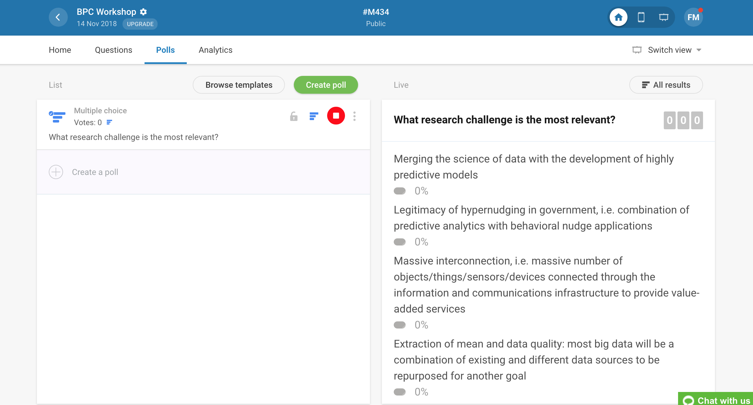
Voting

Slide 17
Thank You Very Much!
Dr. Francesco Mureddu - francesco.mureddu@lisboncouncil.net
This project has received funding from the European Union’s Horizon 2020 research and innovation programme under grant agreement No 769623
www.BigPolicyCanvas.eu

Slide 18
Matching Gaps and Research Challenges
Increase transparency and acceptance of data driven digital applications for policy making (NEED)
Is fomented by many trends that are expected to “deliver” in the near future (e.g. large-scale experiments based on big-data-driven nudging techniques - hypernudging)
Is served by tools that are operational and will be use more in the future (ASSETS) (e.g. machine learning algorithms)
Thus, the gap is defined as the necessity to change the modus operandi in order to increase transparency and acceptance of such techniques. A change in the way such tools are developed and used is needed (research need), in order to cope with the need of citizens
Research challenges related to data powered collaborative governance
Assessment of legitimacy of hypernudging in government, boiling down to transparency and co-creation of algorithms (Misuraca)

Slide 19
Explaining the Research Challenge
Assessment of legitimacy of hypernudging in government (Misuraca and Parycek)
Nudging is a form of choice architecture that alters people’s behaviour in a predictable way without forbidding any options or significantly changing their economic incentives: ‘soft’ form of design-based control (Thaler & Sunstein, 2008)
Big Data decision-making takes the form of algorithmic decision-guidance techniques
By highlighting correlations between data items that would not otherwise be observable, these techniques are being used to shape the informational choice context in which individual decision-making occurs, with the aim of channeling attention and decision-making in directions preferred by the ‘choice architect’ (Yeung 2016)
Therefore Big Data can rely on nudging: these techniques can be used for social profiling or personalized public services
Big Data analytic nudges are extremely powerful due to their continuously updated, dynamic and pervasive nature, working through algorithmic analysis of data streams from multiple sources offering predictive insights concerning habits, preferences and interests of targeted individuals (hence hypernudging: Acquisti, et al., 2015)

