Slide 1
Mihkel Solvak mihkel.solvak@ut.ee
Center of IT Impact Studies (CITIS)
University of Tartu
Estonia
Challenges of the use of Big Data in Digital Government

Slide 2
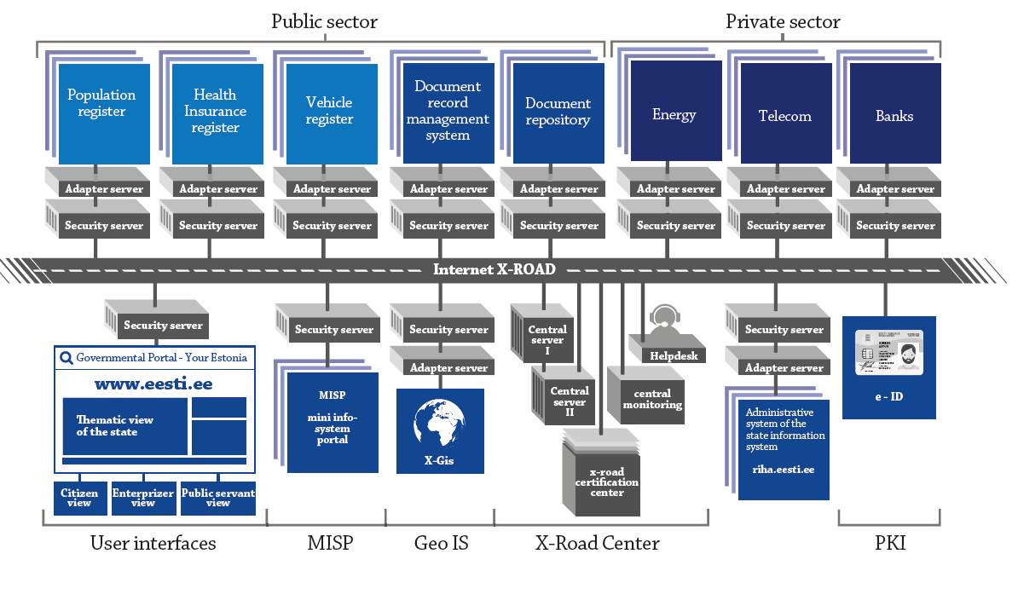
X-Road data exchange layer

Slide 3
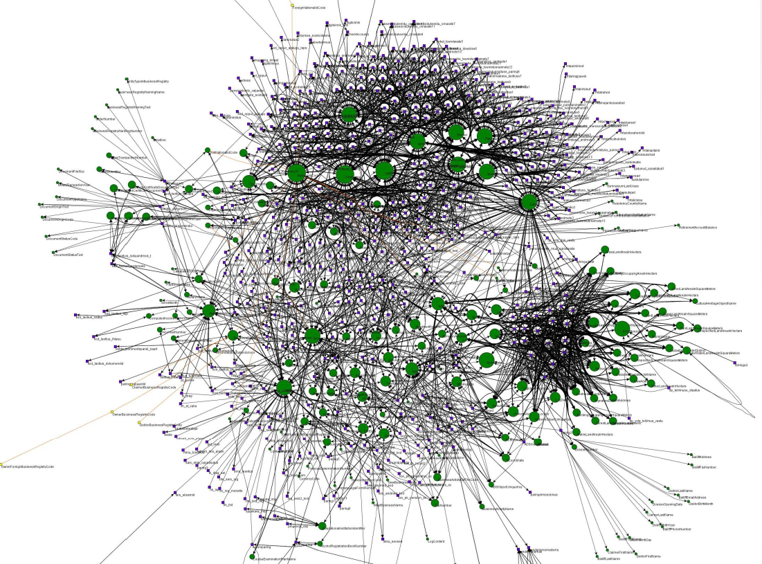
X-Road data exchange layer
https://www.x-tee.ee/factsheets/EE/#eng
3001 e-services
518 public + 673 private institutions providing and consuming services (52 000 institutions using indirectly)
570 million service call queries annually
4.1 billion service calls since 2002 in central log

Slide 4
ADDING VALUE TO DATA FOR DECISION MAKING &
SPEED UP POLICY CYCLE
Text goes here

Slide 5
Real-time predictive economics

Slide 6
Real-time predictive economics
Declaration data
  ~ 166 000 monthly declarations
  Comparable time-series from 2002-2016, i.e. 16 years
Goals:
  Monitor
  Provide input for probability based decisions
  Forecast for planning
Notes:
We operated with 75 000 companies, 10 million rows, 50 variables, aorund 500 million observations. For all 166 000 companies translates to 16*12*50*166 000=1.6 billion observations.

Slide 7
Real-time predictive economics
Notes:
We operated with 75 000 companies, 10 million rows, 50 variables, aorund 500 million observations. For all 166 000 companies translates to 16*12*50*166 000=1.6 billion observations.

Slide 8
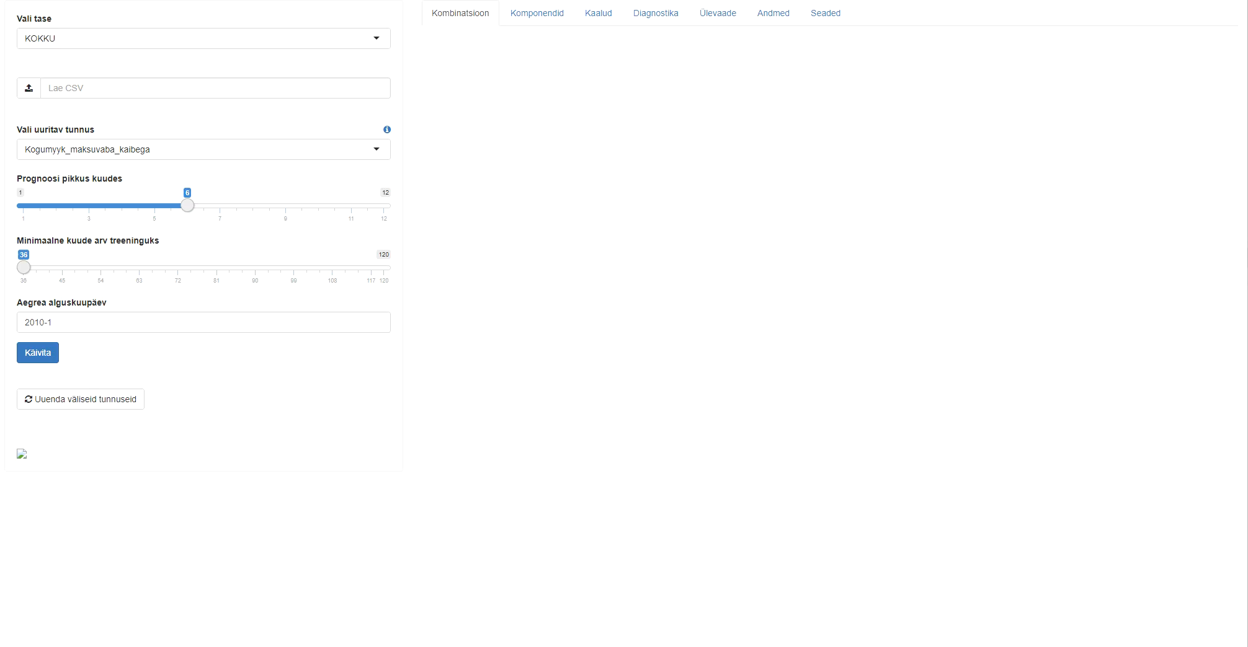
Real-time predictive economics

Slide 9
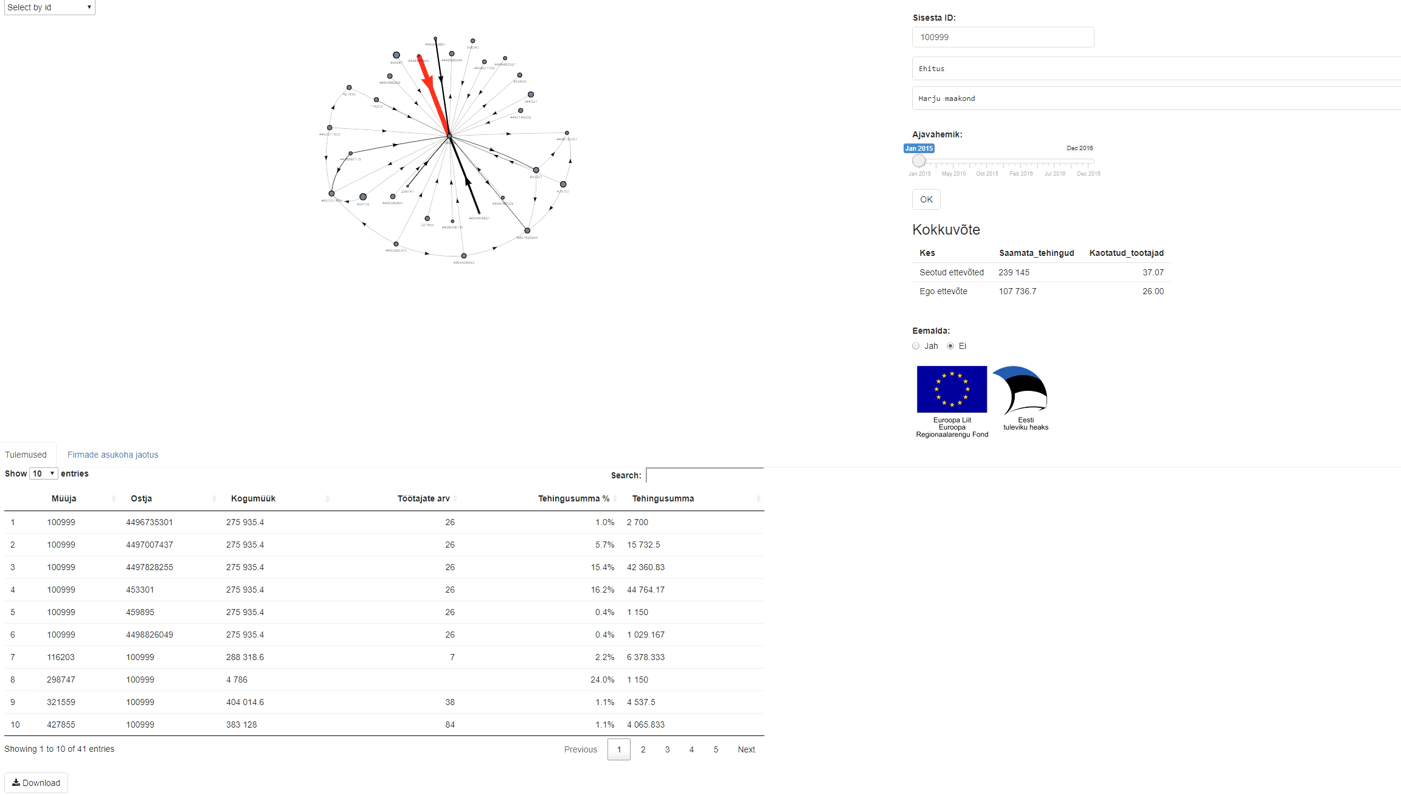
Real-time predictive economics

Slide 10
BEHAVIOR PREDICTING SERVICES USING MACHINE LEARNING TO CHANGE BEHAVIOR
Text goes here

Slide 11
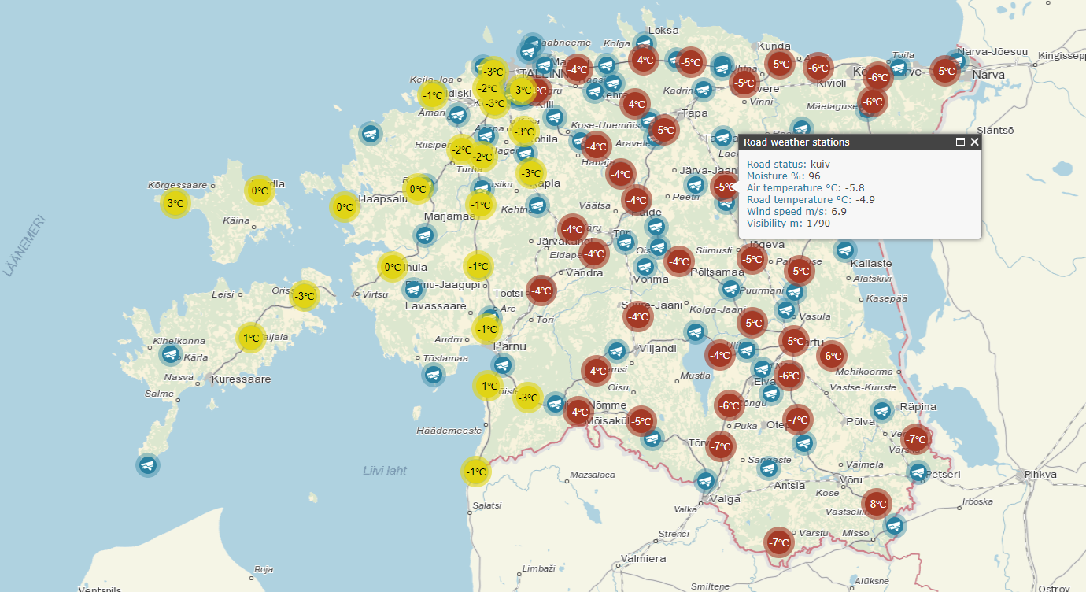
Real-time accident prediction

Slide 12
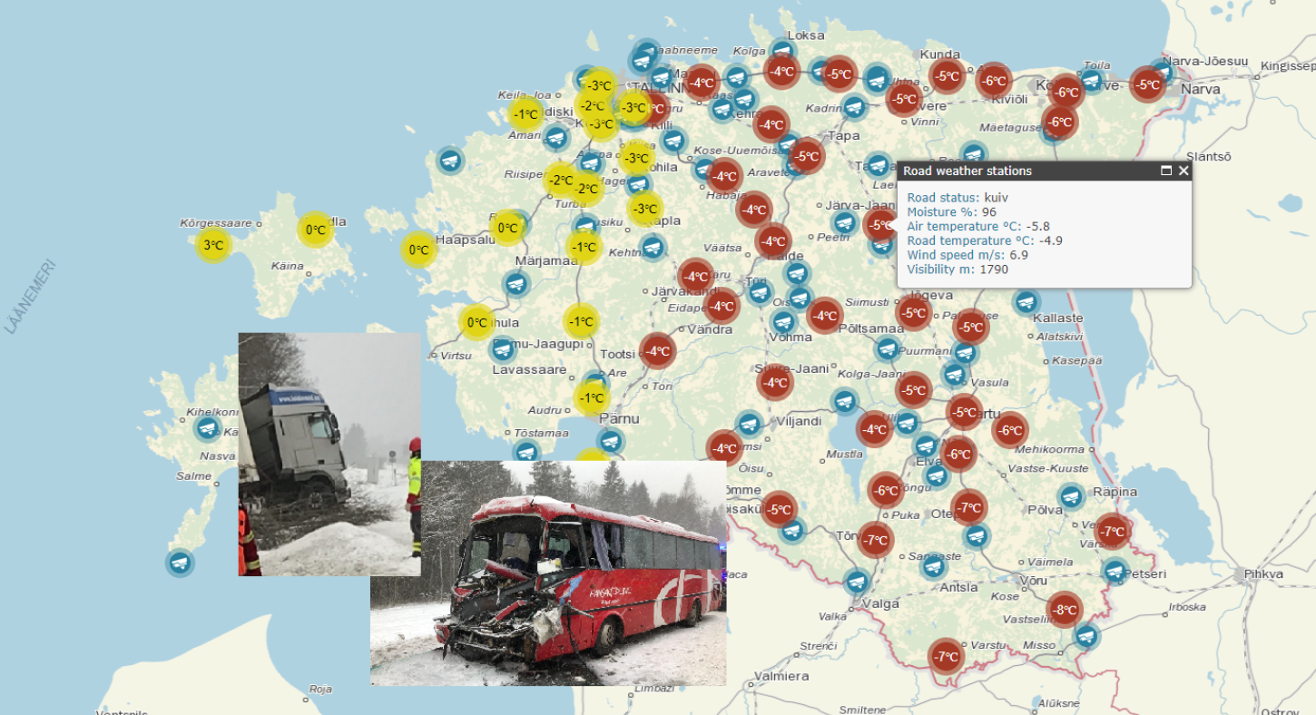
Real-time accident prediction

Slide 13
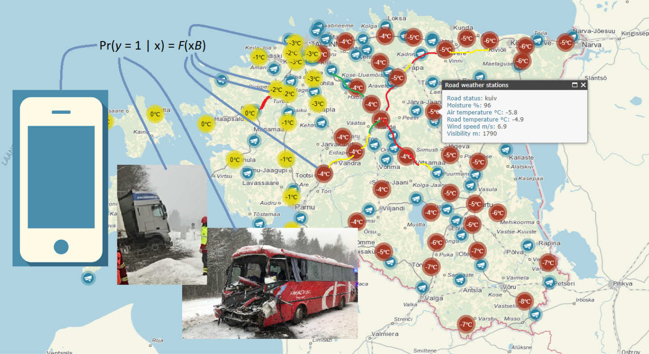
Real-time accident prediction

Slide 14
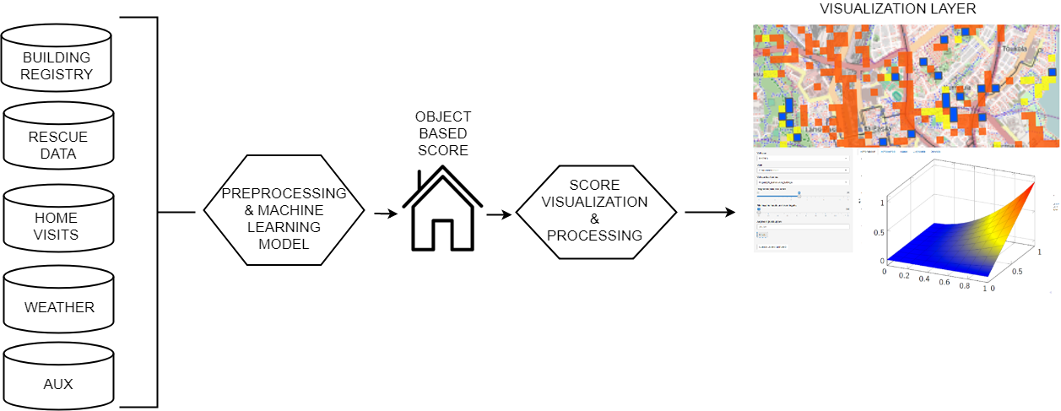
Real-time fire hazard scoring

Slide 15
Thank you!
mihkel.solvak@ut.ee

